Slide 1

Datiz and the
Whale Shark
Learning and Teaching Resources for English Language (P4 - 6)
Developed by English Language Education Section
Curriculum Development Institute
Education Bureau

Slide 2
Learning Objectives:
To arouse students’ awareness of endangered species in the world
To develop students’ empathy, respect and a sense of responsibility for animals
To develop students’ reading skills and writing skills on animal issues

Slide 3
Pre-reading activities
Refer to Worksheet p.1
Learn more about the topic of the reader “Datiz and the Whale Shark” by completing the following pre-reading activities.
Activity 1:
Watch the video clip and fill in the blanks to complete the description of whale sharks.
Activity 2:
What is “blast fishing”? Read the part “Glossary” in the reader and find out its meaning.
Activity 3:
How does blast fishing affect our marine life? Watch the video clip and tick its negative impact.

Slide 4

Pre-reading activities:
Activity 1
What are whale sharks?
Whale sharks are gentle giants of the ocean. They have ________ spots and their heads are wide and _______. They are not mammals. They are the largest shark and _______ in the world. They can grow to _______ metres long. Although they are huge, they eat plankton, krill and small fish. They eat by _____ eating. They swim thousands of miles each year to _______ waters.
They are an endangered species because fishermen catch them for _______, or they get tangled in fishing ________ or struck by boats. Increasingly laws are made to _________ them and ban fishing for them, because they are a _________ attraction and people come from all over the __________ to where they are known to be found or to aquariums keeping them.
white
flat
fish
12
filter
warm
food
nets
protect
tourist
world

Slide 5
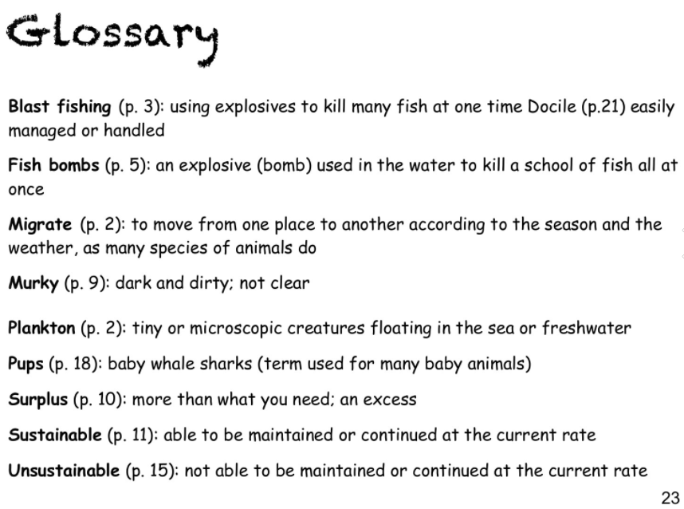
Pre-reading activities:
Activity 2
What is “blast fishing”?
Blast fishing means people use ___________ such as bombs to kill many fish at one time.
explosives

Slide 6

Pre-reading activities:
Activity 3
How does blast fishing affect marine life? Tick its negative impact.
◻ | (a) Many fish species which are of no use to the fishermen are killed.
◻ | (b) Most target fish species sink to the seabed where the fishermen can’t reach.
◻ | (c) A lot of coral reefs are demolished, which takes around a century to recover.
◻ | (d) All of the above.
✓

Slide 7
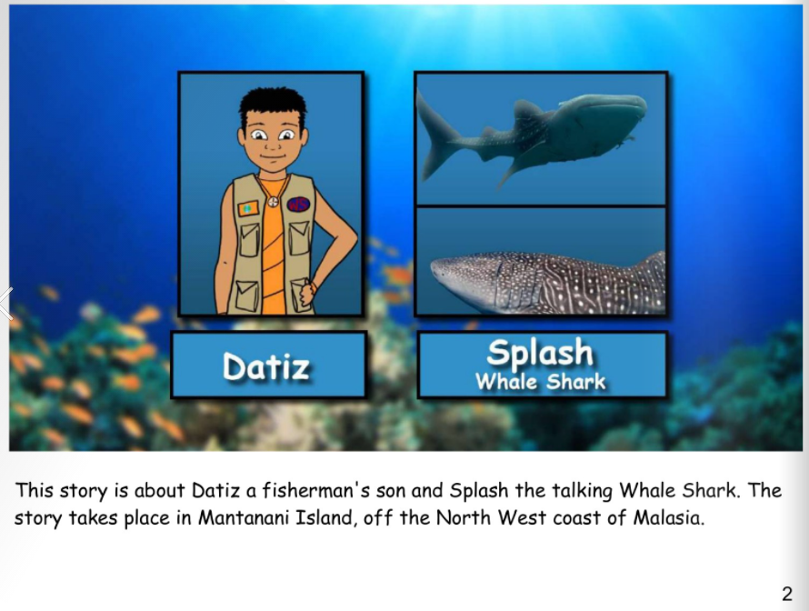
While-reading activities:
Refer to Worksheet p.2
Characters and Setting

Slide 8
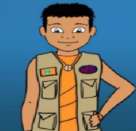

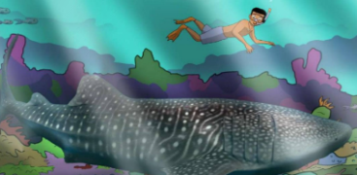
While-reading activities:
Characters
(Who were the characters?)
The main characters were _____and the (talking) _____ _____ (Splash).
Datiz
Whale
Shark
(b) Setting
(Where did the story take place?)
The story took place on __________ Island.
Mantanani

Slide 9
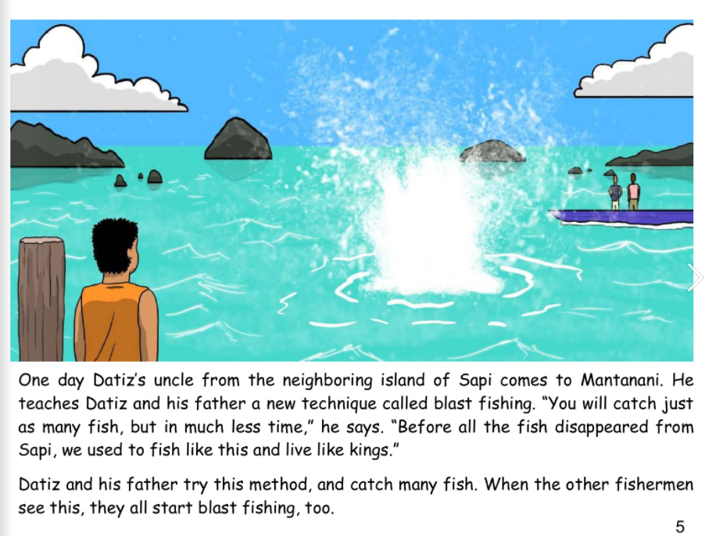
While-reading activities:
Problem

Slide 10
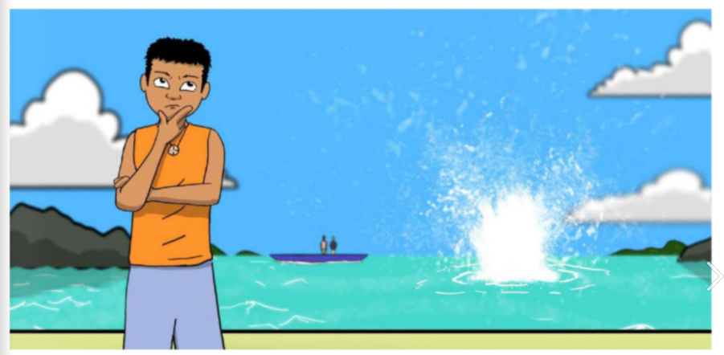
While-reading activities:
(c) Problem
(What happened in the sea?)
When _______ arrived, ________ dived into the water and found his friend ________. They suddenly heard a loud BOOM, and saw a mess of bubbles, ________ coral and _____ fish floating to the surface.
March
Datiz
Splash
broken
dead
Before the people learned about the bad side of the new fishing method, what did they care about?
Before the people learned about the bad side of the _________ _________, they only cared about the amount of fish caught.
blast
fishing

Slide 11
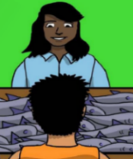
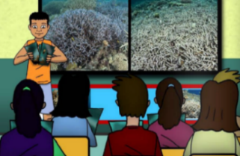
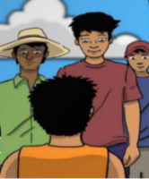

“We, fishermen, can catch _________ _________ to sell at the market!
“We, chefs, can buy fish ___________ and sell meals at ___________ prices!”
Before knowing the bad side of blast fishing
more
cheaply
fish
lower
“We, merchants, can sell _________ __________ to chefs!”
“We, customers, can pay for meals at ________ prices!”
more
fish
lower

Slide 12
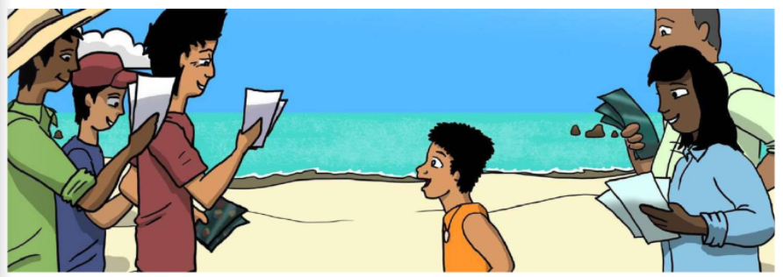
While-reading activities:
(d) Solution
(What did the character do? What did the people want to do?)
_______ conducted talks and showed the people pictures of the terrible ________ of blast fishing. They wanted to _______ the reefs and the fish after learning about its bad side.
Datiz
effects
protect
Solution

Slide 13
“We, chefs, will not _________ fish that are caught using fish bombs because ____________ want us to cook the sustainably caught fish!
After knowing the bad side of blast fishing
“We, fishermen, feel _______ to have no more coral reefs and fish!
buy
sad
customers
“We, merchants, won’t ________fish that are caught with fish bombs! We must tell the _____________.”
“We, customers, only want to have fish that are caught in a ___________ way!”
sell
sustainable
fishermen

Slide 14
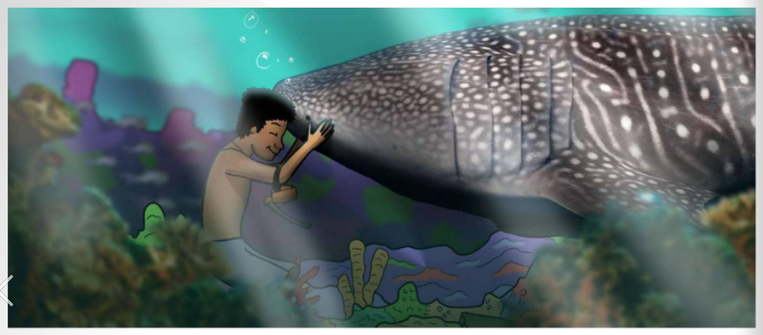

While-reading activities:
(e) Moral/ Message
If we protect our marine life from further damage, they will _________.
To protect the environment, it is important to educate all the ________.
recover
people
Moral

Slide 15
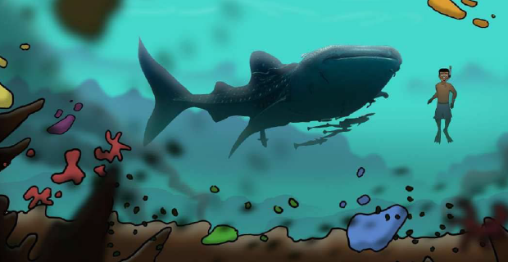
Post-reading activities:
1. Using linking words to express contrasting ideas
Refer to Worksheet p.3
Even though | the chef has plenty of fish for his customers now, | it is not sustainable.
Although | the merchant has many fish to sell at low price now, | soon she will have none.
the subordinate clause – the original idea:
People only care about the amount of fish caught now / the price of fish sold now.
the main clause – a different idea:
There will be no more fish in the future.
linking words/ conjunctions
Other examples:
Soon all the coral reefs will be destroyed though the fishermen can catch a lot of fish now.
It is not a sustainable way to catch fish even though the price of fish is cheaper.
the main clause
When the main clause comes first, we don’t need to use a comma.
the subordinate clause

Slide 16
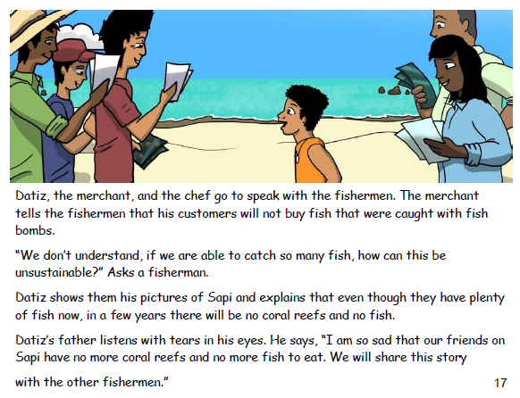
Post-reading activities:
1. Using linking words to express contrasting ideas
Even though | the chef has plenty of fish for his customers now, | it is not sustainable.
Although | the merchant has many fish to sell at low price now, | soon she will have none.
the subordinate clause – the original idea:
People only care about the amount of fish caught now / the price of fish sold now.
the main clause – a different idea:
There will be no more fish in the future.
linking words/ conjunctions
Underline the sentence with contrasting ideas from the following page:

Slide 17
Post-reading activities:
1. Using linking words to express contrasting ideas
Refer to Worksheet p.3
Even though | the chef has plenty of fish for his customers now, | it is not sustainable.
Although | the merchant has many fish to sell at low price now, | soon she will have none.
the subordinate clause – the original idea:
People only care about the amount of fish caught now / the price of fish sold now.
the main clause – a different idea:
There will be no more fish in the future.
linking words/ conjunctions
The original idea:
e.g. plastic bottles of water/paper, convenient/cheap
b) It is important to live a green life to reduce waste and protect the environment. Write two sentences to explain to the children why they need to live a green life and how to protect the environment.
Even though it is convenient to buy plastic bottles of water, …
You should save paper and use both sides of each sheet of paper before throwing it away though …
e.g. Although it is comfortable to turn on the air-conditioner, it will cause global warming.
A different idea: reduce waste and protect the environment

Slide 18
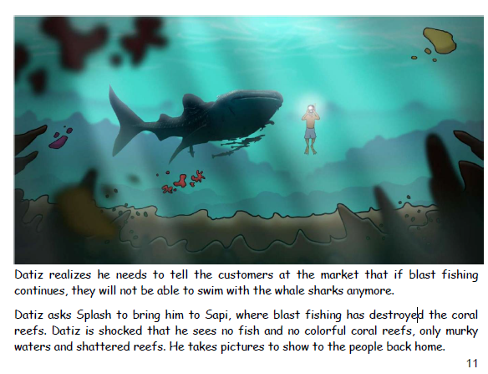
Post-reading activities:
Using conditional sentences to
express cause-effect relationship
Refer to Worksheet p.4
If clause to explain the Cause:
Effect:
Main clause to explain the result
If people continue blast fishing, | soon there will be no more coral reefs and no more fish for people to eat.
If we protect the coral reefs from further damage, | over time they will recover.
use the simple present tense in the if-clause
use will /can /may + infinitive in the result clause
Underline the sentence with contrasting ideas from the following page:

Slide 19
Post-reading activities:
Using conditional sentences to
express cause-effect relationship
Refer to Worksheet p.4
If clause to explain the Cause:
Effect:
Main clause to explain the result
If people continue blast fishing, | soon there will be no more coral reefs and no more fish for people to eat.
use the simple present tense in the if-clause
use will /can /may + infinitive in the result clause
Cause:
Effect:
b) Many children want to keep a pet. Write two sentences to give advice to the children who want to keep a pet.
If you take good care of your pet, …
If you patiently train your pet so that it develops good manners and behaviour,…
e.g. If you do not think carefully before keeping a pet, it will be a big trouble to you and to your pet.
do not think carefully before keeping a pet
Cause:
Effect:
it will be a big trouble to you and to your pet.

Slide 20


Post-reading activities:
Refer to Worksheet p.5
3a) An interview about Endangered Animals
Context:
You are a young ambassador. You are concerned about the endangered animals and care for the pets. A reporter is interviewing you about animal protection. Answer the interview questions.
Endangered animals
Why?
How?
What?
If we do not protect the endangered animals, they will…
Why is it important to protect the endangered animals?
Although the government has set up laws to protect the endangered animals, …
How can we protect the endangered animals?
What can students do to protect the environment?
If we…, there will be…
Acknowledgement: The two clipart pictures were found from Creative Commons
Notes:
Acknowledgement: The two clipart pictures were found from Creative Commons

Slide 21
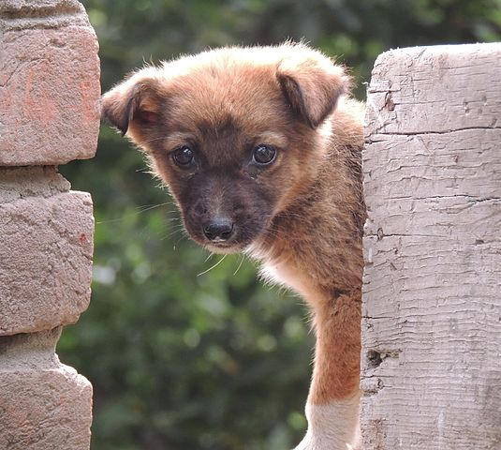
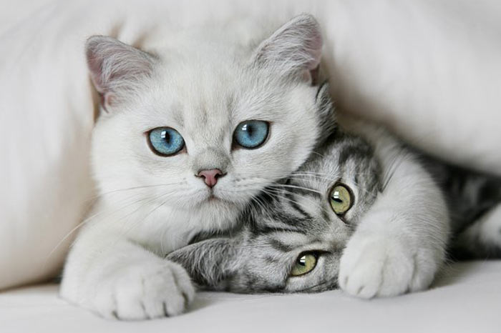
Post-reading activities:
Refer to Worksheet p.5
3b) An interview about Pet Care
Context:
You are a young ambassador. You are concerned about the endangered animals and care for the pets. A reporter is interviewing you about animal protection. Answer the interview questions.
Pet Care
Why?
What?
(One advice)
How?
If you keep a pet, you will…
Why is it good to keep a pet?
If you want to keep a pet, you need to… /
Although the pets look cute and lovely, you need to…
Can you give some advice to your friends if they want to keep a pet?
How can we keep a healthy pet dog?
If you want to keep a healthy pet dog,…
Acknowledgement:
The two photos and two clipart pictures were found from Creative Commons.
Notes:
Acknowledgement: The two photos and two clipart pictures were found from Creative Commons.

Slide 22
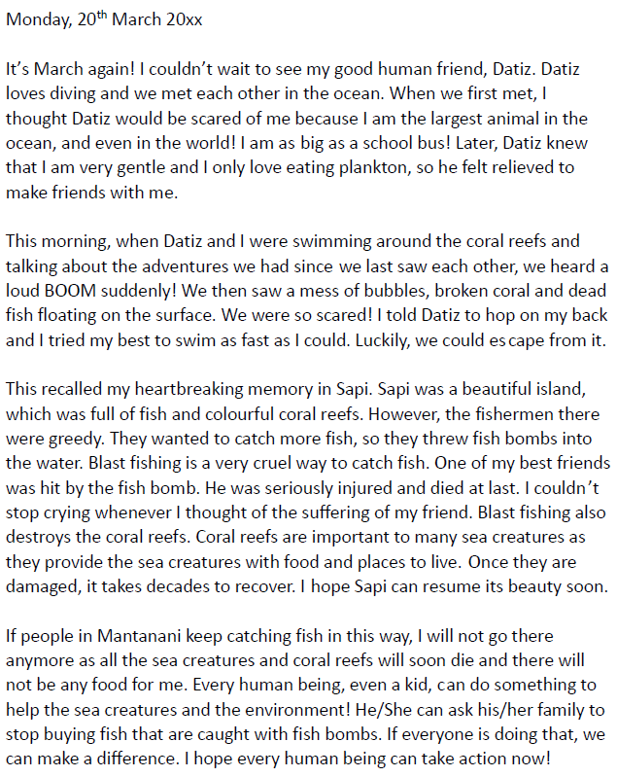
Pre-writing
Understand the content and organisation of the diary entry
A diary entry from the perspective of the whale shark
date
The ____ is at the top of the diary entry.
Refer to Worksheet p.7
Paragraph 1:
Where can you find the whale shark?
How does it look like?
What is its favourite food?
Paragraphs 2 & 3:
How did the people catch fish?
Why was this fish catching method cruel?
How did it affect the environment?
Paragraph 4:
What can people do to help the whale shark and other sea creatures?

Slide 23
Pre-writing
Understand grammar items and language used in the diary entry
A diary entry from the perspective of the whale shark
Refer to Worksheet p.8
past
Use the simple ____ tense to write about things that happened, e.g. I couldn’t wait to see my good human friend, Datiz.
present
Use the simple ______ tense to state the fact, e.g. I am as big as a school bus!
Use personal pronouns,
e.g. __________.
“I” and “we”
feelings
Include your ________ and thoughts, e.g. We were so scared!
hopes
Include your ________, e.g. I hope Sapi can resume its beauty soon.
Don’t forget to:
use a friendly tone
describe the events in the order they happen

Slide 24
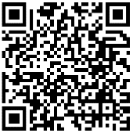
Writing a diary entry
1. Information search
Cruel practices to pet dogs | Reasons
Chaining dogs _________ ______________________ Keeping them _________ | Dogs are ______ animals who need and deserve _______________, _____________ and ___________________________. These practices prevent them from _________ _______________ and is just a way for ________________________________________ ________________________________________ until they get around to taking care of them properly.
Cruel, unnecessary _____________ that is performed on dogs, e.g. ______________________ __________ and ________ | Human _____________ or ______________ ________ and __________ to dogs They are ____________ in many countries, but they remain legal in ____________
d. ____________ of animals | It may cause animal _________________ crisis. The consequences are _________________ and often _________________.
Refer to Worksheet p.9 & p.10
to a post
social
all day and night
companionship
exercise
mental stimulation
in cages
satisfying
all their needs
guardians to ignore and store their dogs in a
place like a warehouse as if they were goods
convenience
preference
surgery
Painful
traumatic
banned
ear-cropping,
the U.S.
tail-docking
debarking
Hoarding
overpopulation
serious
fatal for animals

Slide 25
Writing a diary entry
2. Ideas for shared writing
Write a diary entry about the cruelty you experience in a day and what you would like your owner to do for you.
Context
Imagine that you were a pet dog living with your owner, Amy, in an apartment. Amy has to work all day. For the sake of convenience, Amy puts you in a cage before she goes to work early in the morning and takes you out late at night when she returns home.
You are planning to write a diary entry about the cruelty you experience in a day and what you would like your owner to do for you. You may use the information in Part 1 to help you brainstorm ideas.
Refer to Worksheet p.10
Paragraph | Ideas
1 | The weather Feelings
fine
could see sunshine outside my small cage
unhappy

Slide 26
Writing a diary entry
2. Ideas for shared writing
Write a diary entry about the cruelty you experience in a day and what you would like your owner to do for you.
Refer to Worksheet p.10 & p.11
Paragraph | Ideas
2 | Things that happened with thoughts and feelings In the morning In the afternoon
Amy forgot to put toys in the cage and clean the potty area
all alone in the small and dirty cage
felt depressed
could not exercise
had nothing to do
heard someone shouting loudly as if an accident was going to happen
could not escape
scary

Slide 27
Writing a diary entry
2. Ideas for shared writing
Write a diary entry about the cruelty you experience in a day and what you would like your owner to do for you.
Refer to Worksheet p.11
Paragraph | Ideas
3 | Reflections Thoughts and feelings Things that Amy can do for me
cruel to keep animals alone in cages for long hours
animals have needs and feelings
let me stay out of the cage while she is away
keep another dog to accompany me

Slide 28
Writing a diary entry
3. Shared writing
Write a diary entry about the cruelty you experience in a day and what you would like your owner to do for you.
Refer to Worksheet p.12
Ideas | Paragraph 1
The weather fine could see sunshine outside my small cage Feelings unhappy | Friday, 7 August 20XX The weather was __________________________ _________________________________________ _________________________________________
fine today.
I could see sunshine
outside my small cage.
However, it was just
another unhappy day for me.
Don’t forget to:
use a friendly tone
describe the events in the order they happen
Use the simple past tense to write about things that happened in the past, e.g. I couldn’t wait to see my good human friend, Datiz.
Use the simple present tense to state the facts, e.g. I am as big as a school bus!
Use personal pronouns, e.g. I and me.
Include your feelings and thoughts, e.g. We were so scared!
Include your hopes, e.g. I hope Sapi can resume its beauty soon.

Slide 29
Writing a diary entry
3. Shared writing
Write a diary entry about the cruelty you experience in a day and what you would like your owner to do for you.
Refer to Worksheet p.12
Ideas | Paragraph 2
Things that happened with thoughts and feelings In the morning Amy forgot to put toys in the cage and clean the potty area all alone in the small and dirty cage felt depressed could not exercise had nothing to do In the afternoon heard someone shouting loudly as if an accident was going to happen could not escape scary | As usual, Amy put me in the cage early in the morning. Perhaps, she was busy last night. She only put some water and a little food in the cage but forgot _____________________ ______________________________________ ______________________________________ ___________________________ To add to the unlucky events, _________________________ ____________________________________________________________________________ _______________________
to put toys and clean the
potty area.
I felt depressed as I was all alone
in the small and dirty cage.
I could not
exercise and had nothing to do.
I heard someone shouting
loudly as if an accident was going to happen.
However, I could not escape.
The experience
was really scary!
Don’t forget to:
use a friendly tone
describe the events in the order they happen
Use the simple past tense to write about things that happened in the past, e.g. I couldn’t wait to see my good human friend, Datiz.
Use the simple present tense to state the facts, e.g. I am as big as a school bus!
Use personal pronouns, e.g. I and me.
Include your hopes, e.g. I hope Sapi can resume its beauty soon.
Include your feelings and thoughts, e.g. We were so scared!

Slide 30
Writing a diary entry
3. Shared writing
Write a diary entry about the cruelty you experience in a day and what you would like your owner to do for you.
Refer to Worksheet p.12
Ideas | Paragraph 3
Reflections Thoughts and feelings cruel to keep animals alone in cages for long hours animals have needs and feelings Things that Amy can do for me let me stay out of the cage while she is away keep another dog to accompany me | I think it is cruel to keep animals alone in cages for long hours because _____________________ _________________ I hope Amy ______________ _________________________________________ _________________________________________
animals have needs
and feelings.
can let me
stay out of the cage while she is away
or
keep another dog to accompany me.
Don’t forget to:
use a friendly tone
describe the events in the order they happen
Use the simple past tense to write about things that happened in the past, e.g. I couldn’t wait to see my good human friend, Datiz.
Use the simple present tense to state the facts, e.g. I am as big as a school bus!
Use personal pronouns, e.g. I and me.
Include your feelings and thoughts, e.g. We were so scared!
Include your hopes, e.g. I hope Sapi can resume its beauty soon.

Slide 31
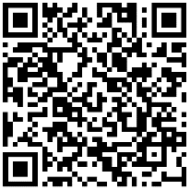
Writing a diary entry
4. Individual writing
Imagine you were a pet, a farm animal or a wild animal. Write a diary entry about the cruelty you experience in a day and what you would like human beings to do for you.
Refer to Worksheet p.13
_____________________ I am a ________________________________________________________ _____________________________________________________________ _____________________________________________________________ __________________________________________________________________________________________________________________________ _____________________________________________________________ ___________________________________________________________________________________________________________ ______________________________________________
Don’t forget to:
use a friendly tone
describe the events in the order they happen
Use the simple past tense to write about things that happened in the past, e.g. I couldn’t wait to see my good human friend, Datiz.
Use the simple present tense to state the facts, e.g. I am as big as a school bus!
Use personal pronouns, e.g. I and me.
Include your feelings and thoughts, e.g. We were so scared!
Include your hopes, e.g. I hope Sapi can resume its beauty soon.

Slide 32
Writing a diary entry
Self-assessment checklist
Complete the self-assessment checklist
Did I do the following? I…
(Please tick “✓”the box if you did it.)
Refer to Worksheet p.14
◻ | include my feelings and thoughts.
◻ | include my hopes.
◻ | used the simple past tense to write about things that happened in the past.
◻ | used the simple present tense to state the facts.
◻ | used personal pronouns.
◻ | used a friendly tone.
◻ | described the events in the order they happened.
◻ | proofread (e.g. check spelling, capitalisation, the use of punctuation marks) my writing before handing it in to my teacher.

Slide 33








Summary
Just like human beings, animals can feel pain, fear, loneliness and love. Therefore, we need to think carefully before keeping a pet. Here are seven suggestions we need to consider before keeping a pet. Identify the elaborations in green text boxes to support the ideas. You may give some other suggestions and explain your ideas.
To have the whole family’s agreement on keeping the pet.
To save abandoned animals and fight puppy mills.
Consider adoption
To provide your pets with proper diets and fresh water, and never buy/adopt a pet on an impulse or give a pet as a present.
Proper care with lifetime commitment
Family acceptance
Things to consider before keeping a pet
To spend time on accompanying, playing and interacting with your pets.
To be responsible for cleaning up the animal waste.
Suitable household environment
Vaccination and neutering
To provide your pets with a clean and comfortable resting area.
Clean up after the pet
Devotion of time
To prevent diseases and reduce certain health risks.

Slide 34
Summary
To save abandoned animals and fight puppy mills.
To provide your pets with proper diets and fresh water, and never buy/adopt a pet on an impulse or give a pet as a present.
Consider adoption
To have the whole family’s agreement on keeping the pet.
Proper care with lifetime commitment
Family acceptance
Things to consider before keeping a pet
Suitable household environment
Vaccination and neutering
To prevent diseases and reduce certain health risks.
To provide your pets with a clean and comfortable resting area.
Clean up after the pet
Devotion of time
To be responsible for cleaning up the animal waste.
To spend time on accompanying, playing and interacting with your pets.

Slide 35





Other suggestions:
Make sure your pets will not get lost
Mind the amount of food your pets eat
Avoid giving improper food to your pets
Consider putting gauze or bars on windows, putting dogs on leash when walking them so that your pets won’t become strays.
Do not overfeed your pets as obese pets could have health problems.
Be aware of what the improper food is and avoid giving it to your pets as it may be toxic for them, e.g. chocolate, grapes, raisins, dairy products, raw meat.

Slide 36

Keeping a pet is a lifetime decision and commitment!
Stop and think twice before it.

Slide 37
Acknowledgements
1. Information and images/pictures in this set of worksheets are taken from the following book published by Word Scientist.org:
Datiz and the Whale Shark by Kelly Case
https://data.booksie.org/word-scientists/datiz-and-the-whale-shark-2.pdf
2. Information on the video about whale sharks is taken from the video clip produced by Free School:
All about Whale Sharks for Children: Whale Shark Video for Kids
https://www.youtube.com/watch?v=jApMS38YR6w
3. Information on the video about blast fishing is taken from the video clip produced by robbielab:
Blast Fishing Aftermath
https://www.youtube.com/watch?v=aFWK-MSg3fo

Slide 38
Acknowledgements
4. Information on the website of People for the Ethical Treatment of Animals (PETA) is adopted in the information search activity to prepare students for the writing task:
Animal Right Issues – Companion Animals – Cruel Practices
https://www.peta.org/issues/animal-companion-issues/cruel-practices/
5. The website of the Society for the Prevention of Cruelty to Animals (SPCA) Hong Kong is introduced in the part on individual writing. Students are encouraged to search for information on the website to understand the cruelty animals are facing and reflect on what animals would like us to do for them.
What is Animal Welfare?
https://www.spca.org.hk/en/animal-welfare/what-is-animal-welfare

Slide 39
6. Information and images/pictures about the things to consider before keeping a pet is taken from the poster produced by Agriculture, Fisheries and Conservation Department:
One Precious Life, One Lifetime Decision
https://www.pets.gov.hk/english/publications_and_downloads/files/OnePreciousLife_OneLifetimeDecision_Poster.pdf

